Slide 1

GBS INFORMATIK
Technology Partner for All industrial AI Needs

Slide 2


Company Overview
GBS empowers energy-intensive industry firms to harness profound insights, enhancing their decision-making in process control. It enables the optimization of industrial applications and ensures operational stability through the utilization of AI and other advanced control solutions
GBS develops state-of-the-art technological solutions for maximized profitability, streamlining complex processes, and advocating safer operating conditions with over 20 years of experience in different industrial processes.
GBS maintains its pioneering role in developing advanced control algorithms and data science strategies, working collaboratively with customers to bolster their achievements. Our objective is to drive holistic performance enhancements, foster business growth, and promote operational excellence alongside our valued clients.

Slide 3


Our Mission
Being a reliable tech partner, we focus on helping our clients make their Industrial process smarter, adopt new sustainable technologies and be more competitive on the market with better process insights

Slide 4

Our Values
Customer Focus:
At GBS, we consider our clients as our valued partners, placing their interests and requirements at the forefront of our priorities. We maintain unwavering dedication to delivering optimal solutions tailored to meet their specific needs.
Innovation & Change:
We are a team of industrial process specialists, academicians, researchers, analysts and developers stimulating innovation in the way we do business with our clients. We embrace and drive constructive change in our business and for our stakeholders.
Excellence:
We discover and define, we measure and analyze, we create and optimize, we monitor and control – that is how we achieve the pinnacles of excellence

Slide 5

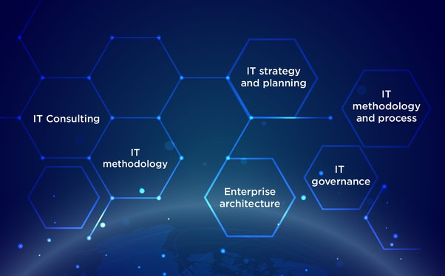
Digitalization
Tools
MPC &
AI Algorithms
Technology &
Consulting
Advanced Process Control Solutions
Process
Optimization
Industry 4.0
Applications
MIS/MES
Solutions

Slide 6


Slide 7

Industrial Process Optimization
Cognus AI : APC Suite
Revolutionary AI-Driven Solutions Transforming Industrial Operations. Multivariable Model Predictive control / Adaptive algorithms are game changers for improving control performance and maximizing energy conservation by automatically bringing the operation closer to optimization.
Benefits:
Increase the Operational efficiency & Plant stability
Maximize the Throughput
Reduce Energy Consumption
Comply with emissions and Carbon footprint
Industries :
Power Plant, Paper & Pulp Plant, Iron & Steel, Alumina, Cement & Other Energy Intensive Plants

Slide 8
Cognus AI – APCSuite
Cognus AI Components
Cognus AI Deliverables
Cognus AI
Features
AI Algorithms
MPC Algorithm
Economic Cost based Algorithm
UI Interfaces
Configurable and Informative
Industrial PC Operating Systems
Windows
Linux
Communication
OPC UA/ DA
TCP/IP
UDP
Typical Objectives
Maximizing Efficiency
Operate to Maximum Constraints
Manipulated Variables
Throughput
Energy
Equipment Setpoints
Constraints
Motor Limitations
Mill Circuit over-loading
Controlled Variables
Production/ Energy Targets
Simplicity
User Friendly
Easy Troubleshooting and maintenance
Flexible & Scalable
Customizable and adaptable to
Process dynamics
Process modifications
Operational strategies
Includes frontier technologies in
Mathematical Optimization
Process Control
Software Engineering
Machine Learning

Slide 9
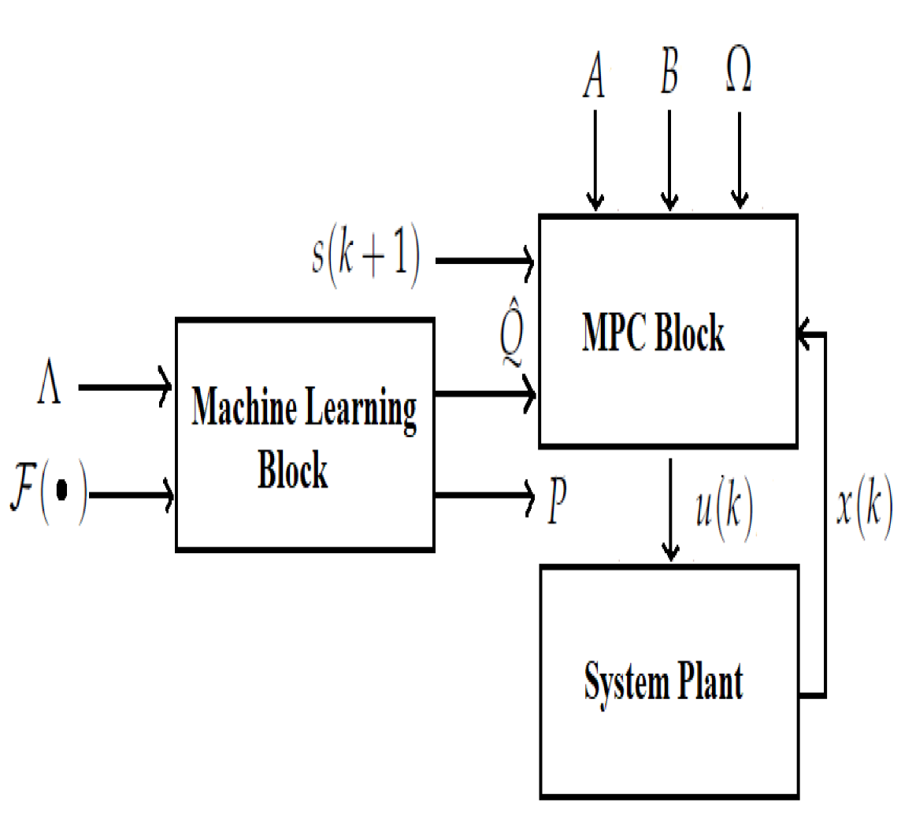
Prognosis AI - MPC
MPC - Model predictive control technology with Adaptive Mathematical models for
In modern control systems, AI techniques are integrated with traditional MPC control strategies to achieve better results.
Uncertainty and nonlinearity of a process, and the non-convexity of the resulting optimization problem can make online implementation of MPC nontrivial.
Aspect | Artificial Intelligence (AI) | Conventional Model Predictive Control (MPC)
Definition | AI involves the development of algorithms and systems that mimic human-like intelligence, learning, and decision-making. | MPC is a control strategy that uses a dynamic model of the system to predict future behaviour and optimize control inputs.
Objective | AI aims to mimic human cognition, solve complex problems, make predictions, and automate decision-making, while MPC focuses on Optimizing Control. | Conventional MPC only focuses on optimizing control inputs to achieve desired system behaviour while considering constraints.
Learning | AI systems can learn from data (machine learning) or be rule-based (expert systems). MPC combined with AI can reap much benefits | MPC relies on predefined models and doesn't inherently learn from data
Complexity Handling | AI-based MPC can handle complex, nonlinear systems and adapt to changing conditions. | Conventional MPC is suitable for linear and some nonlinear systems but can struggle with highly complex or nonlinear processes.

Slide 10
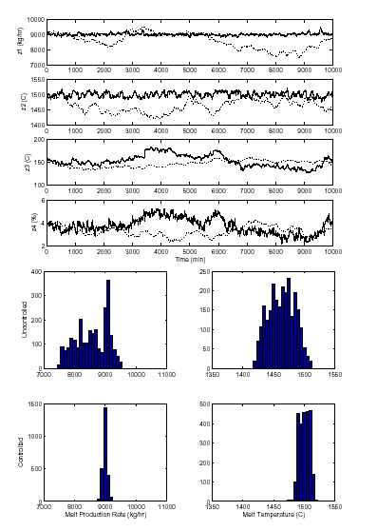
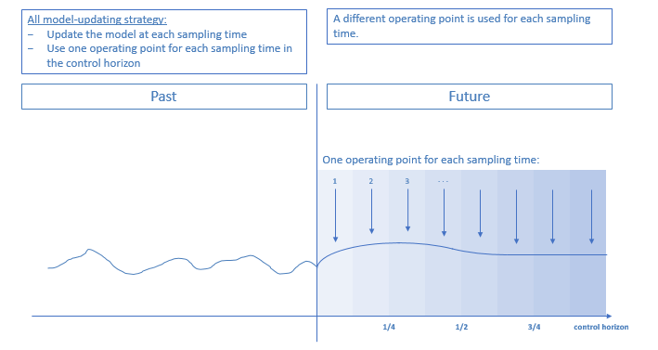
Prognosis AI – MPC Control Overview
Controller consists of a matrix of process model pairs that explain IMPORTANT INTERACTIONS in the process…
Predict the values of the CVs by movement of all the MVs and DVs
Proactive Control to achieve CV setpoints, prevent them from being violated, hence reducing variability
Controller Matrix
CV1
CV2
CV3
MV1
MV2
NO MODEL
NO MODEL
MV3
DV1
DV2
NO MODEL

Slide 11
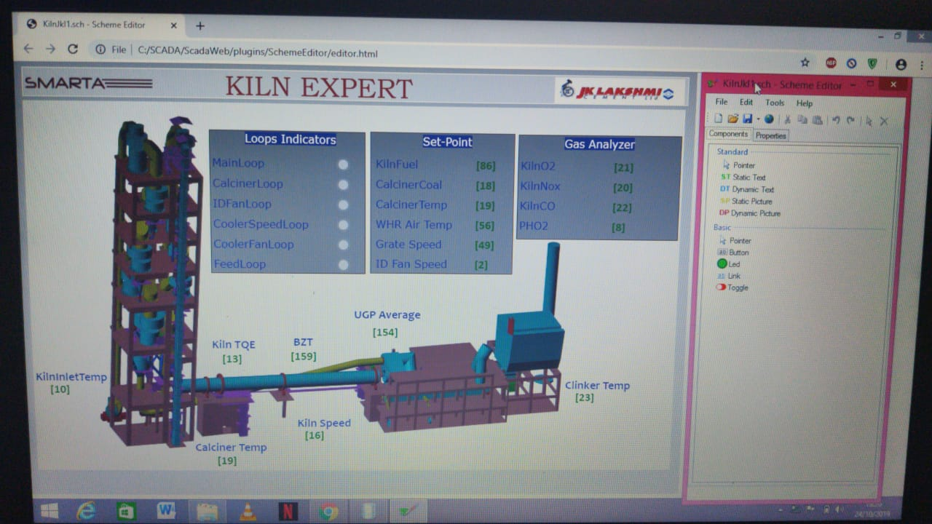
Prognosis AI – APC Suite (Operator Interface)

Slide 12




Prognosis AI – APC Benefits
Energy Optimization
Reduce Power/Fuel consumption
Uniform Operation
Stable operation result in Smooth Process irrespective of various shift operators thereby minimizing machine wear and tear
Consistent Product Quality
Predictive Control can ensure desired quality target is achieved
Minimize Emissions
With Consistent process control and Real Time Optimization can strictly maintain the emission value under desired limits
Energy Savings
Throughput
Increase
Process & Quality Stability

Slide 13
Prognosis AI Capabilities In
Mineral Plants
SAG/ AG Mills
Floatation Circuits
Others
Captive Power Plants
Bio Reactors
Paper plants
Copper/ Nickel Plants
Food Processing units
Spray Dryers
Cement Plants
Kiln/Cooler
Cement Mill
Raw Mill
Coal Mill
Power Grid Optimization
Future Plants
Power Grid Optimization
Higher Capacity Power Plants
Sinter Plant
Sponge Iron Plant
Coke Oven Plant
Blast Furnace
Under Progress

Slide 14





GBS Digital Portfolio
"GBS possesses extensive expertise and a wealth of experience in delivering automation solutions tailored to varying business requirements, ranging from Level-II automation to Level-V automation."
Business Management
Business-critical management information systems
Optimization
Process-optimizing high-level control solutions
Supervision
GBS
Applications for monitoring and controlling systems
Control System
Automation systems that run all plant processes
Sensors & Actuators
Process Signals providing real-time data

Slide 15

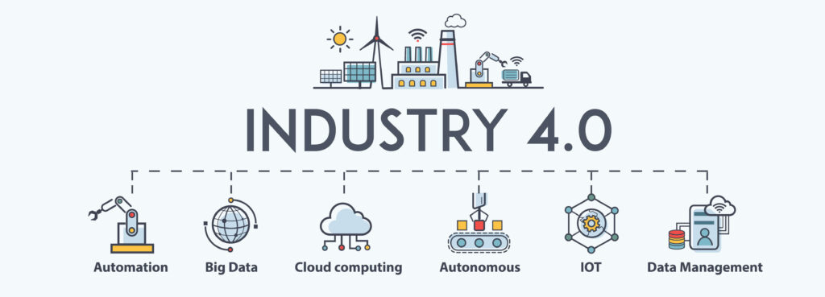

GBS Industry 4.0 Solutions
What
Operational Monitoring
Performance Monitoring
Business KPIs
How
Real time data acquisition from Plants
Key data acquisition from SAP
Converting these data to KPI
Data – Information – Insight
We offer wide range of solutions to cater Industry 4.0 needs through our partner network
From Basic Automation till Advanced Data Analytics & ER

Slide 16








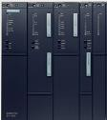
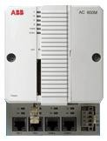
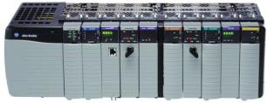


Industry 4.0 Digital Solution Architecture
Existing Corporate Network
Access over Web Browser
Mobility
Internet Link
Corporate
Broadband
Security (Over TLS 443)
User Authentication
Data Encryption
Customer Corporate Network
Existing Level 1 Network
Firewall
Data Collector Node
Operator Station
Engineering Station
Database Servers
Plant Network

Slide 17
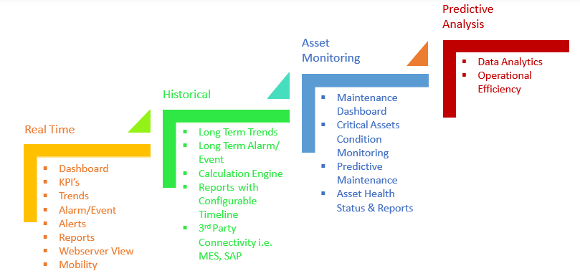
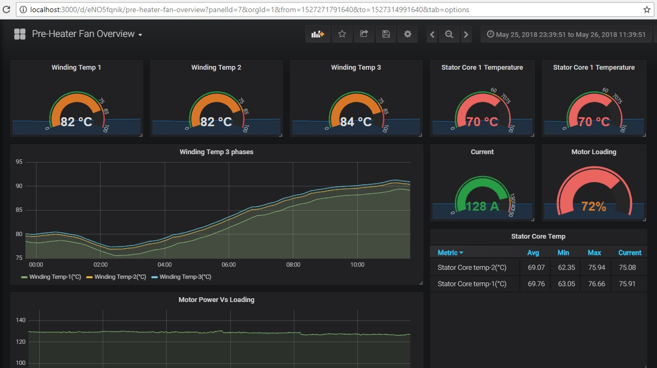
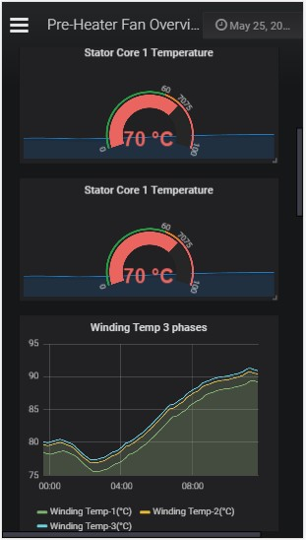
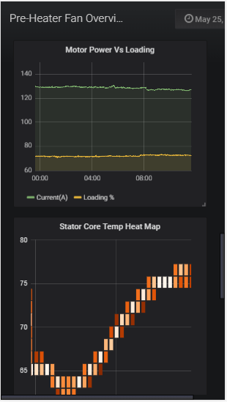
GBS Industry 4.0 Digital Transformation
Flexible & Scalable based on budget availability

Slide 18
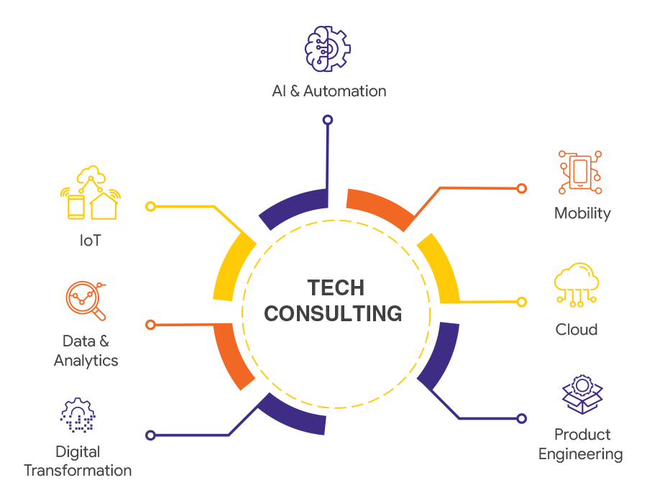
GBS Automation / Digital Consulting Services
GBS leverage its immense Technical knowledge and Domain expertise to perform various Tech Consulting and Professional services:
AI Partnership programs
Plant Automation Audit Services
Cybersecurity Audits
Digital Transformation & Consultancy services
Data Analytics & ML Research support
Big data/Cloud/IOT support

Slide 19

GBS Value Propositions
End to End Cost Effective Solutions
Trusted Partner
Dedicated Lifecycle Support
Strive to Provide Continuous Performance Improvements suiting your Business Needs
Industrial
Knowledge
Technology
Partner
Academic
Research
Software
Innovation

Slide 20




Delivering Beyond Expectations
info@gbsinformatik.com
Nungambakkam, Chennai
044-35505136

